Slide 1
DEPARTMENT OF COMPUTER SCIENCE
Sellgros
Submitted By: Sarvesh, Vidhyabhushan, Skanda

Slide 2
Database Design
Introduction
Database is a collection of related data. Relational database stores data in a table or relations. The data stored in a relation are arranged in records. Each record consists of set of attributes. Fields can be referred to characteristics of records. This document describes the table that is used to design software, its attributes, data types, constraints and relationship among those tables.

Slide 3
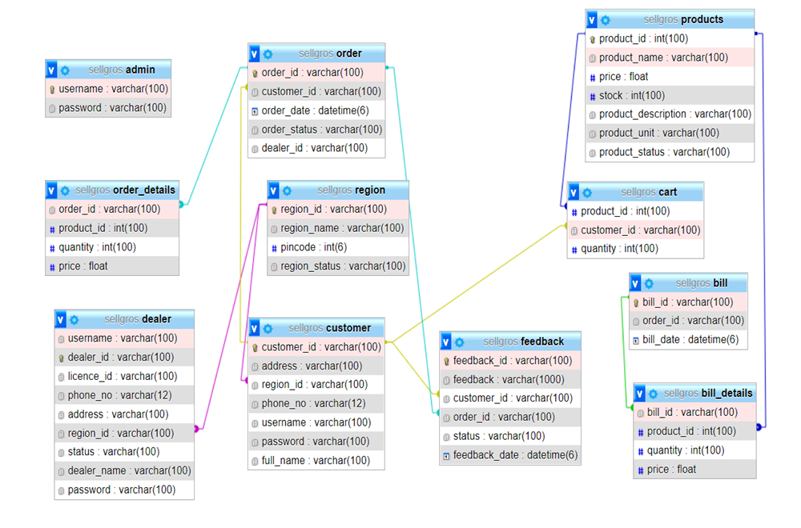
Database schema

Slide 4
Table Definition
DEALER TABLE
Column name | Data type | Size | Constraint | Description
username | varchar | 100 | Not null | User name of the dealer
dealer_id | varchar | 100 | Not null (primary key) | Id of the dealer
licence_id | varchar | 100 | Not null | License id of dealer
phone_no | varchar | 12 | Not null | Phone no. of the dealer
address | varchar | 100 | Not null | Address of the dealer
region_id | varchar | 100 | Not null (foreign key) | Region_id of the dealer
status | varchar | 100 | Not null | Status of the dealer
dealer_name | varchar | 100 | Not null | Name of the dealer
Password | varchar | 100 | Not null | Password of the dealer

Slide 5
Customer table
Column name | Data type | Size | Constraint | Description
customer_id | Varchar | 100 | Not null (primary key) | Id of the customer
address | Varchar | 100 | Not null | Address of the customer
region_id | Varchar | 100 | Not null (foreign key) | Region_id of the customer
phone_no | Varchar | 12 | Not null | Phone no. of the customer
username | Varchar | 100 | Not null | Username of the customer
password | Varchar | 100 | Not null | Password of the customer
full_name | Varchar | 100 | Not null | Fullname of the customer

Slide 6
Admin table
Column name | Data type | Size | Constraint | Description
username | Varchar | 100 | Not null | Username of the admin
password | Varchar | 100 | Not null | Password of the admin

Slide 7
Region table
Column name | Data type | Size | Constraint | Description
region_id | varchar (primary key) | 100 | Not null | Id of the region
region_name | Varchar | 100 | Not null | Name of the region
pincode | Int | 6 | Not null | Pin code for the region
Region_status | varchar | 100 | Not null | Status of the Region

Slide 8
product table
Column name | Data type | Size | Constraint | Description
product_id | Int | 100 | Not null (primary key) | Id of the product
product_name | Varchar | 100 | Not null | Name of the product
Price | Float |  | Not null | Price of the product
Stock | Int | 100 | Not null | Stock of the project
product_description | Varchar | 100 | Not null | Description of the product
product_unit | Varchar | 100 | Not null | Unit of the product
Product _status | varchar | 100 | Not null | Status of the product

Slide 9
order table
Column name | Data type | Size | Constraint | Description
order_id | Varchar | 100 | Not null (primary key) | Id of the order
customer_id | Varchar | 100 | Not null (foreign key) | Id of the customer
order_date | Datetime | 6 | Not null | Date of the order
order_status | Varchar | 100 | Not null | Status of the order
dealer_id | Varchar | 100 | null | Id of the dealer

Slide 10
order_details table
Column name | Data type | Size | Constraint | Description
order_id | Varchar | 100 | Not null (foreign key) | Id of the order
product_id | Int | 100 | Not null (foreign key) | Id of the products
quantity | Int | 100 | Not null | Quantity of the product
price | float |  | Not null | Price of the product

Slide 11
cart table
Column name | Data type | Size | Constraint | Description
product_id | Int | 100 | Not null (foreign key) | Id of the products
customer_id | Varchar | 100 | Not null (foreign key) | Id of the customer
quantity | Int | 100 | Not null | Quantity of the product

Slide 12
bill table
Column name | Data type | Size | Constraint | Description
Bill_id | Varchar | 100 | Not null(primary key) | Id of the bill
Order_id | Varchar | 100 | Not null | Id of the order
Bill_date | Datetime | 6 | Not null | Date of the bill

Slide 13
bill_details table
Column name | Data type | Size | Constraint | Description
Bill_id | Varchar | 100 | Not null (foreign key) | Id of the bill
Product_id | Varchar | 100 | Not null (foreign key) | Id of the products
quantity | Int | 100 | Not null | Quantity of the products
price | Float |  | Not null | Price of the products

Slide 14
Feedback table
Column name | Data type | Size | Constraint | Description
feedback_id | Varchar | 100 | Not null (primary key) | Id of the feedback
feedback | Varchar | 1000 | Not null | Feedback about order and dealer
customer_id | Varchar | 100 | Not null (foreign key) | Id of the customer
order_id | Varchar | 100 | Not null (foreign key) | Id of the order
status | Varchar | 100 | Not null | Status of the feedback
feedback_date | Datetime | 6 | Not null | Date of the feedback

Slide 15
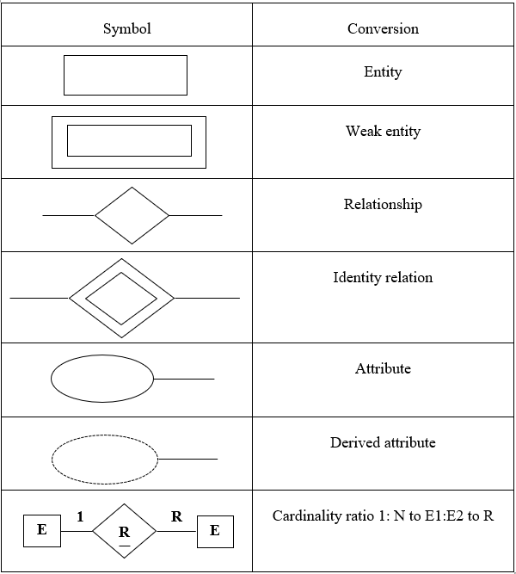
ER DIAGRAM

Slide 16
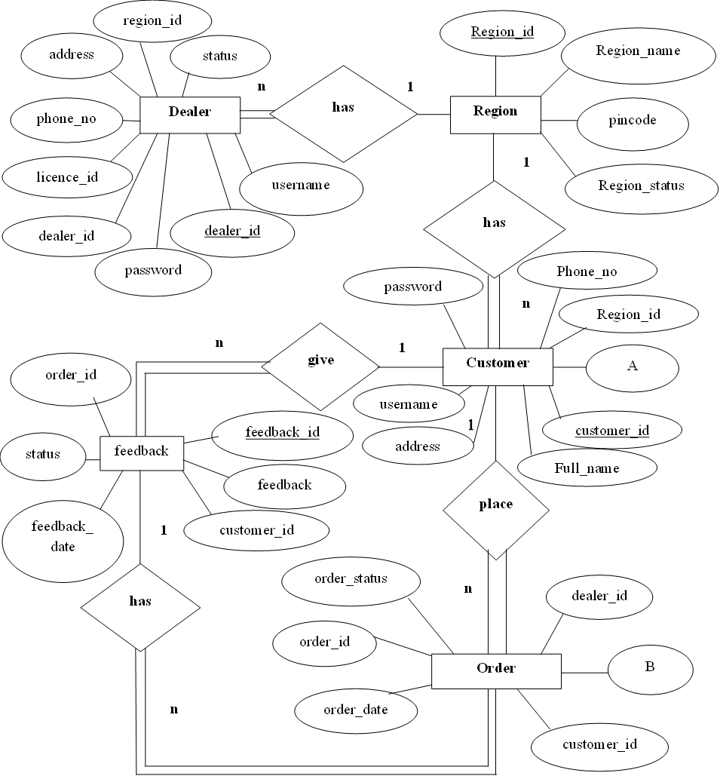

Slide 17
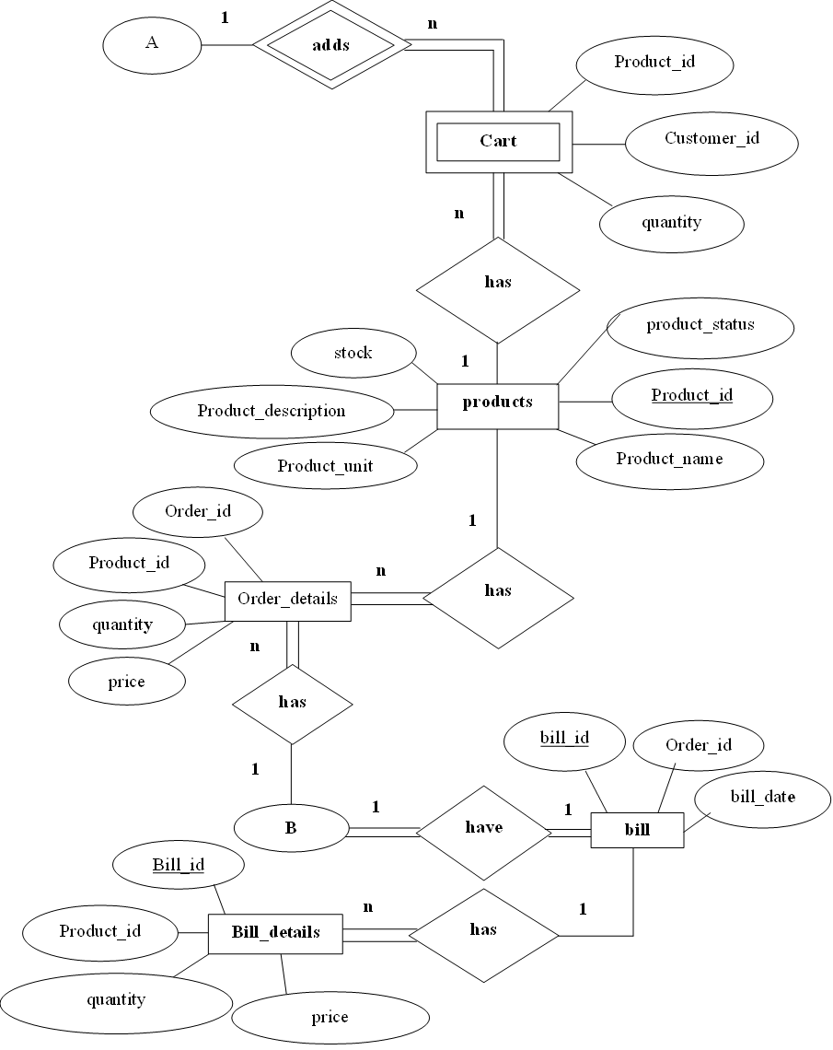

Slide 18
Detail Design
Introduction
During detailed design, the internal logic of each module specified in system design is decided. During this phase further details of the modules are decided. Design of each of the modules usually specified in a high-level description language which is independent of the language in which software eventually be implemented.

Slide 19
Structure of the system
Login
Customer Registration
Registration
Dealer Registration
Product management
Add
Admin
Update
Active/Inactive
SellGross
Dealer authorization
Dealer allotment
Add
Region management
Update
View Feedback
Active/Inactive
Pending order
Dealer
Previous order
Bill generation
Customer
Cart
Modify cart
Place order
Previous order
View bill
Pending order
Feedback

Slide 20
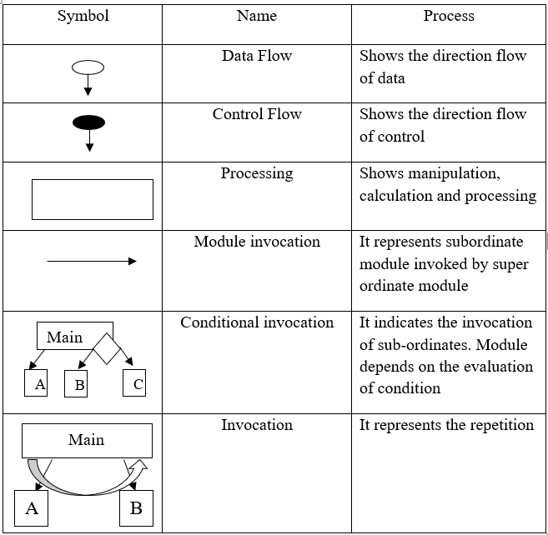
Structure Chart

Slide 21
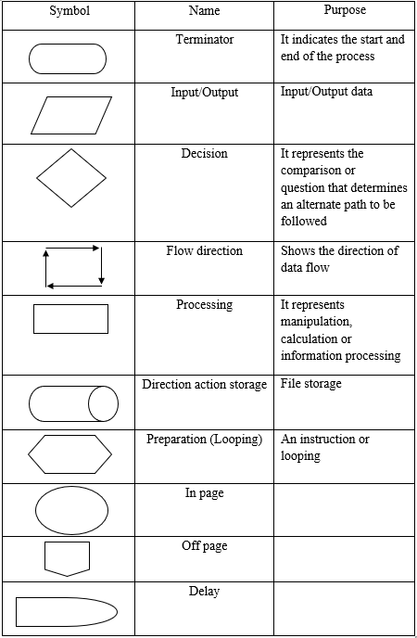
Flow Chart

Slide 22
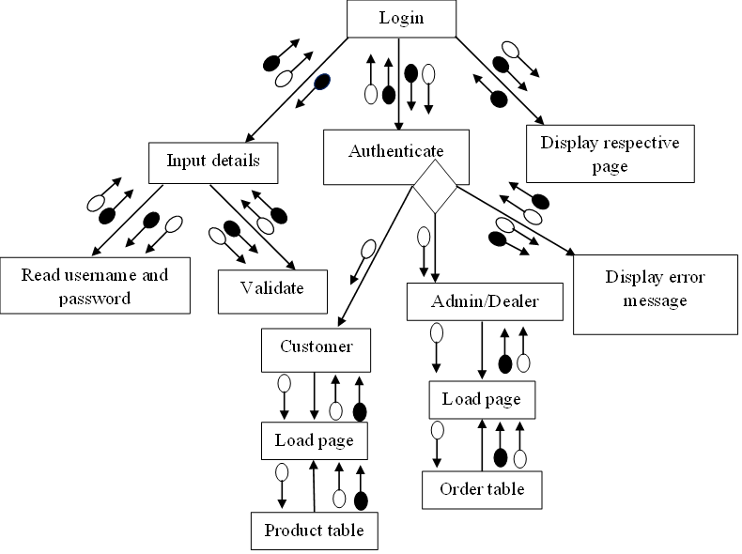
Login

Slide 23
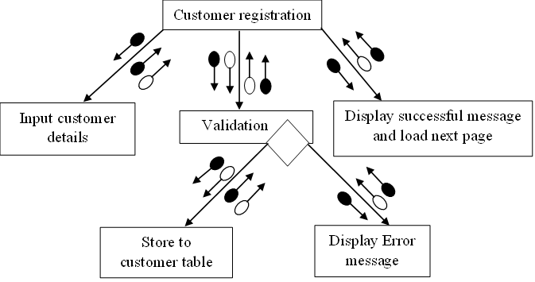
Registration Customer

Slide 24

Dealer

Slide 25
Admin Product Management Add
Start
Product Details
Validation
Product
If exists
Display error message
True
False
Store to database
Product added successfully message
Stop

Slide 26
Update
Start
Click on update
Product
Make changes
Click on update product
Update database
Show successful message
Stop

Slide 27
Active/Inactive
Step:1 Start
Step:2 CLICK on set as
active/inactive button
Step3: IF active THEN
UPDATE product table SET status as active
ELSE IF inactive THEN
UPDATE product table SET status as inactive
Step4: DISPLAY message as product status has been changed
Step5: END

Slide 28
Dealer Authorization
Step1: Start
Step2: retrieve dealer details where status is pending
Step3: CLICK on accept or reject
Step4: IF accept THEN
SET status as approve
END IF
IF reject THEN
SET status as reject
END IF
Step5: END

Slide 29
Dealer Allotment
Step1: Start
Step2: CLICK on DEALER ALLOTMENT
Step3: retrieve orders from order table where dealer_id is NULL
Step4: retrieve customer order details from order details table
Step5: retrieve region from dealer table where region_id in dealer table
Step6: SHOW orders and dealer_id
Step7: SELECT dealer_id from dropdown list
Step8: CLICK on allot button
Step9: assign dealer_id to orders and UPDATE
dealer_id in order table
Step10: END

Slide 30
Region Management Add
Start
Region Details
Validation
Region
If exists
Display error message
True
False
Store to database
Region added successfully message
Stop

Slide 31
Update
Start
Click on update
Region
Make changes
Click on update region
Update database
Show successful message
Stop

Slide 32
Active/Inactive
Step1: Start
Step2:CLICK on active/inactive button
Step3: IF active THEN
UPDATE region table SET status as active
ELSE IF inactive THEN
UPDATE region table SET status as active
Step4: DISPLAY message as region status has been changed
Step5: END

Slide 33
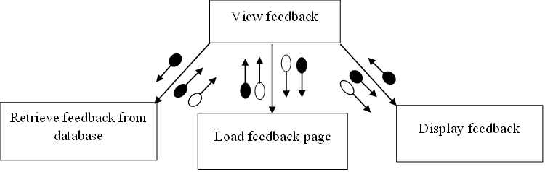
View feedback

Slide 34
Dealer Pending orders
Step1: start
Step2: CLICK on pending order
Step3: retrieve orders where dealer_id in order table and order_status is pending.
Step4: DISPLAY orders with generate bill button

Slide 35
Previous orders
Step1: Start
Step2: CLICK on previous order
Step3: retrieve order where order_status is processed in order table
Step4: retrieve order_id where order_id in order table
Step5: DISPLAY orders.
Step6: END

Slide 36
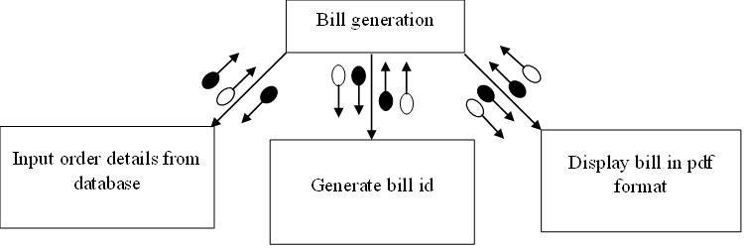
Bill Generation

Slide 37
Customer Modify cart
Step1: start
Step2: CLICK on add to cart button
Step3: retrieve product_id from
product table
Step4: retrieve customer_id from
customer table
Step5: store to cart table
Step6: CLICK on cart
Step7: retrieve details from cart table
Step8: SET quantity by increasing or\
decreasing
Step9: store quantity to cart table

Slide 38
Place order
Start
Click on Place order
Retrieve details from cart
Cart
Generate order id
Order details
Store to database
Order
Order placed successfully message
Stop

Slide 39
Previous order View bill
Start
Click on view bill
Retrieve bill from database
Bill
Show bill
Stop

Slide 40
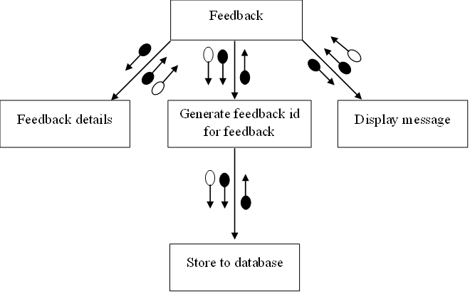
Feedback

Slide 41
Pending orders
Step1: Start
Step2: CLICK on pending orders
Step3:retrieve orders from order table where dealer_id is NULL
Step4: DISPLAY orders which are pending

Slide 42
THANK YOU

